Slide 1
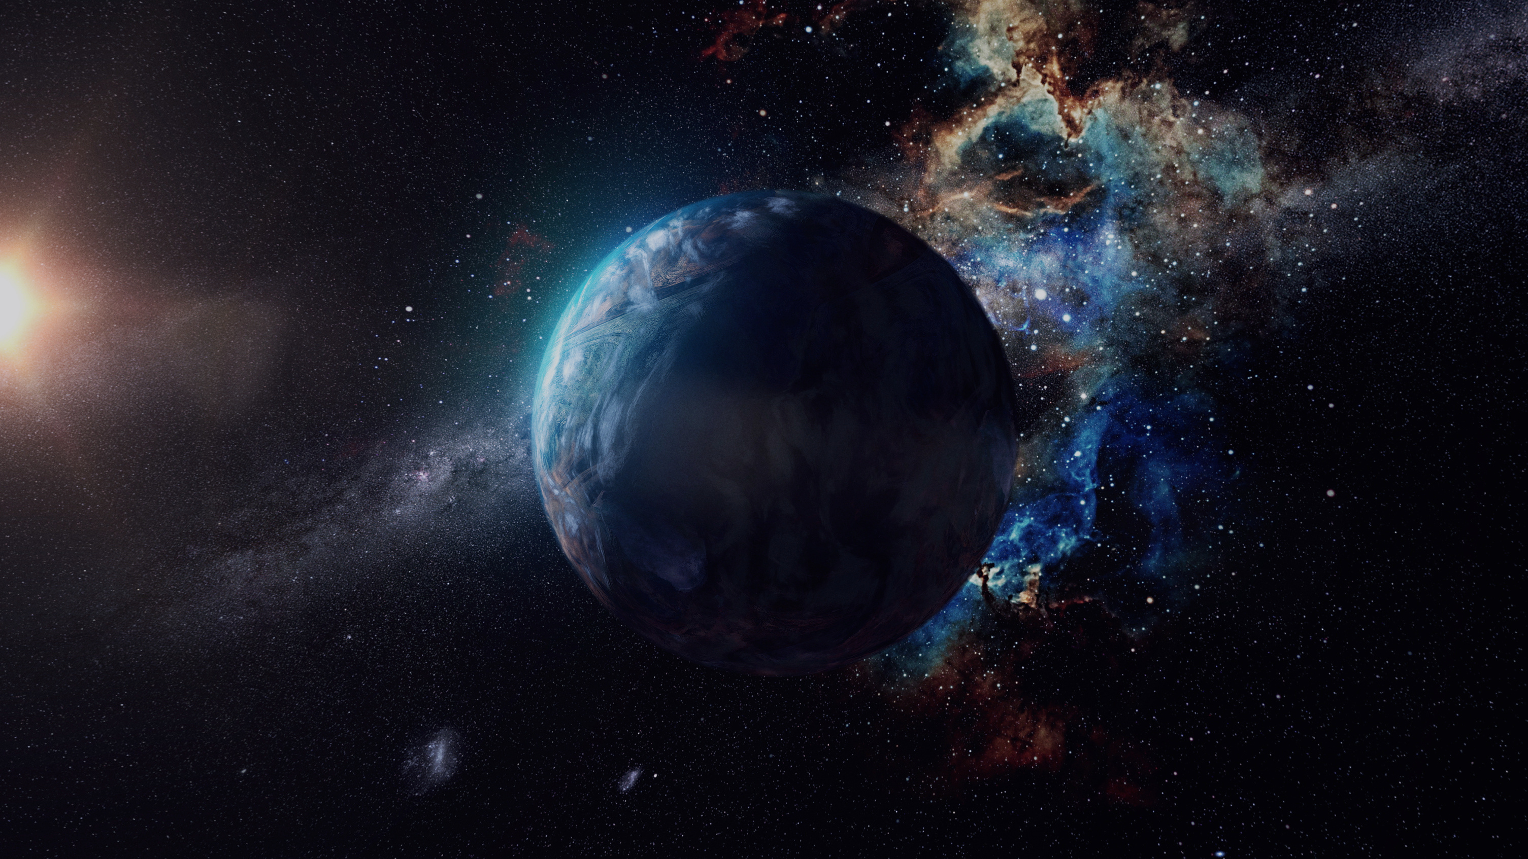



High Mass X-Ray Binaries:
Stars That Sculpt The Universe
Francesco Busini B.S. Mechanical Engineering
Diego Spross B.S. Aerospace Engineering
Mentor: Dr. Pragati Pradhan Department of Physics
Page 01

Slide 2
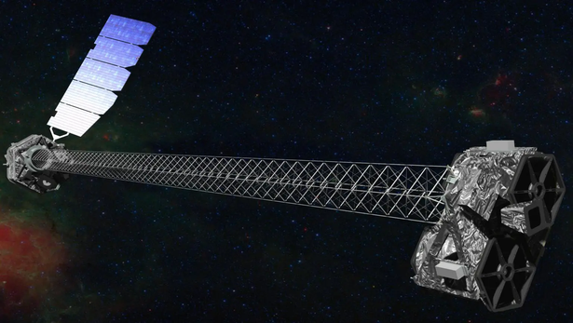
What is NuStar?
  NuSTAR (Nuclear Spectroscopic Telescope Array):
    A space-based X-ray observatory launched by NASA in 2012.
    Designed to detect high-energy X-rays (3-79 keV) with unprecedented sensitivity and resolution.
    Enables detailed studies of black holes, neutron stars, supernova remnants, and high-energy phenomena.
Page 02

Slide 3
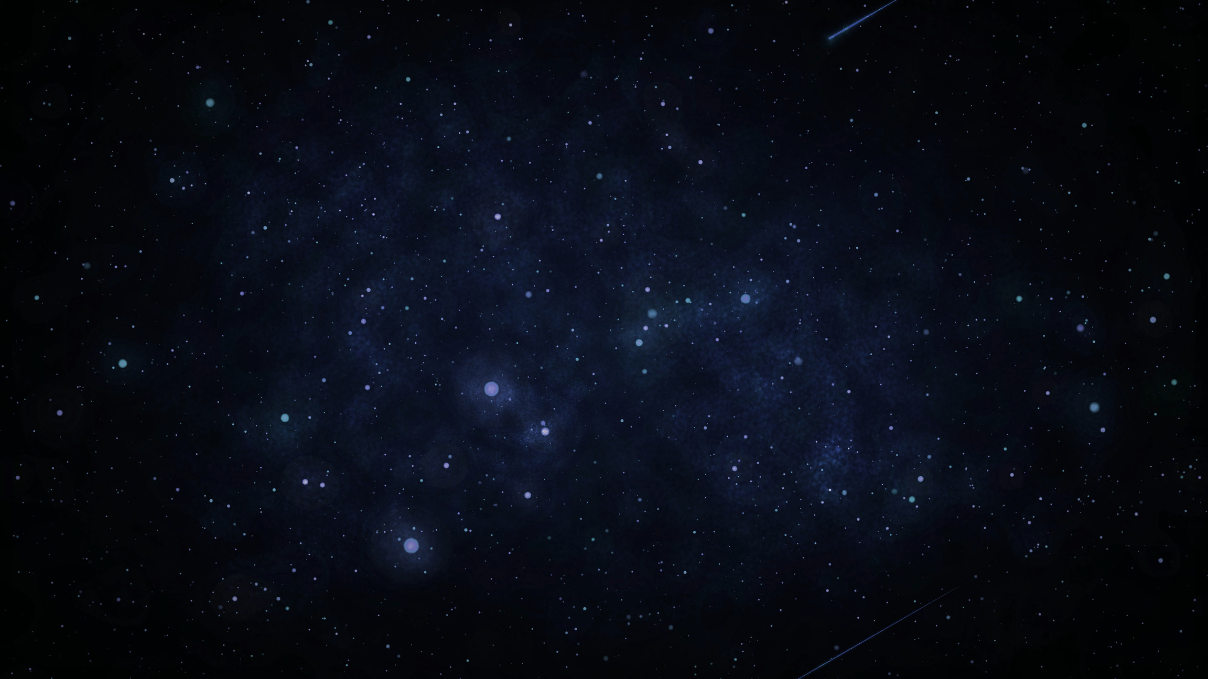
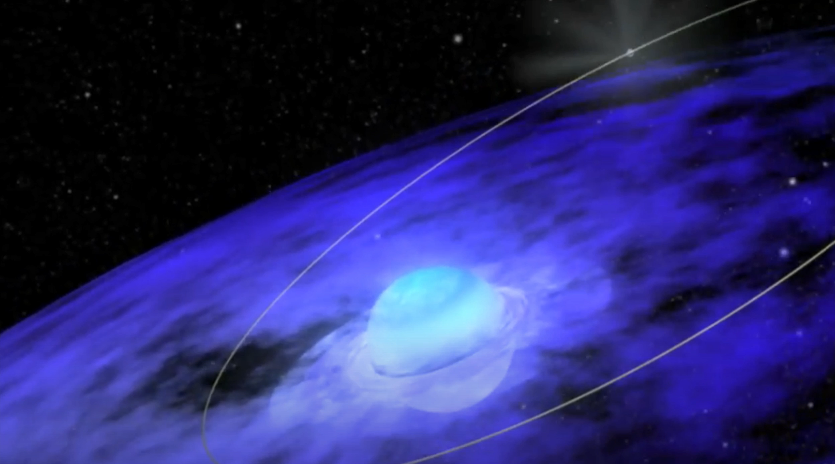
Research Background
What are High Mass X-Ray Binaries (HMXBs)?
Binary systems with a massive star and a compact object.
Importance in Astrophysics:
X-Ray production through interaction between star and object.
Key for understanding stellar winds’ impact on galaxy formation
Page 03

Slide 4
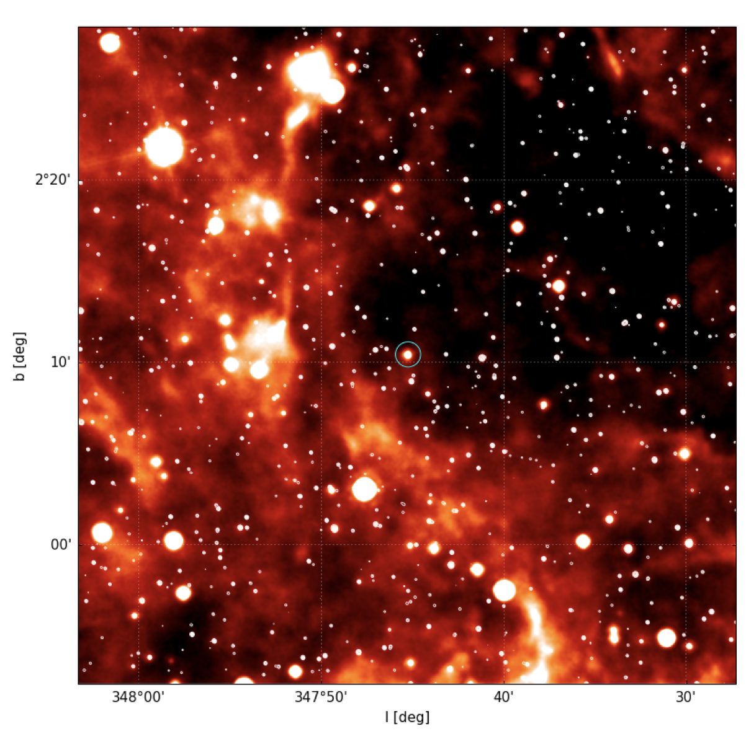
Research Background Continued
  Clumpy Stellar Winds & X-ray Variability
    Winds are clumpy, causing X-ray emission variability.
    Estimates size, density, and mass, refining wind models
  Research Focus
    HMXB 4U 1700-371 using NuSTAR telescope data
https://arxiv.org/pdf/1811.06781
Page 04

Slide 5
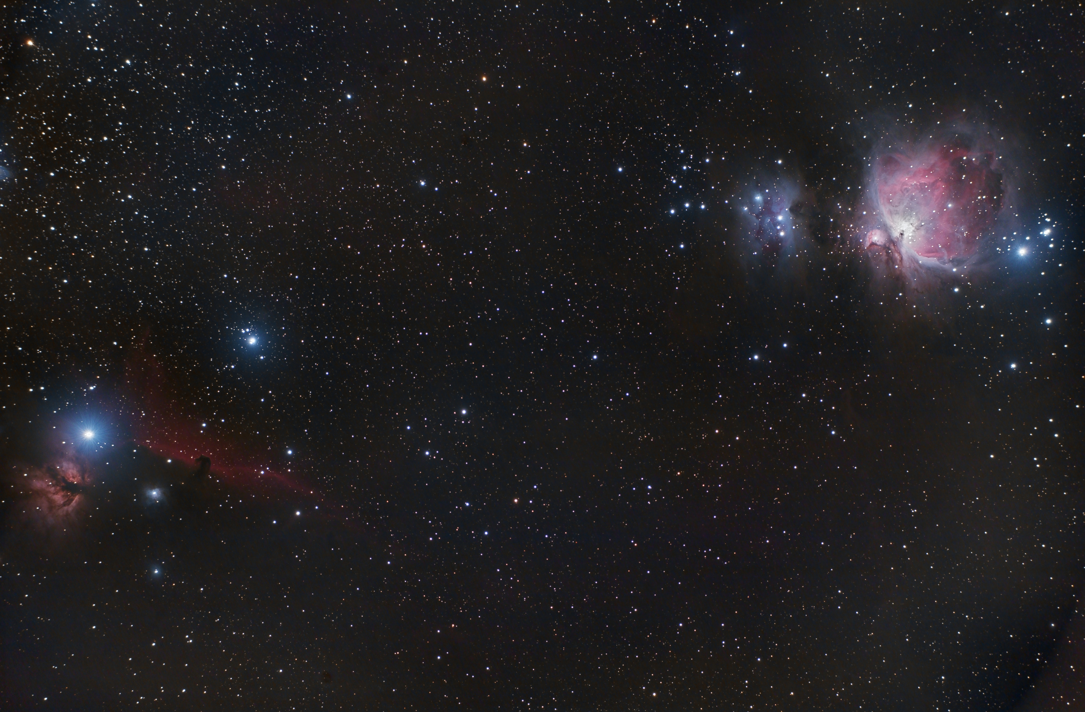
Research Focus
HMXB 4U 1700-371 (Using NuSTAR Data)
  Objective: Study clumpy stellar winds and their impact on X-ray emissions
    Analyze X-ray variability to understand clump behavior
    Measure soft X-ray absorption and hardness ratio for clump size, density, and composition. Examine iron line emissions to assess ionization states of wind clumps.
  Expected Outcomes:
    Obtaining mass, density, and size of clumps
    Refine models of stellar winds and HMXB dynamics
Page 05

Slide 6
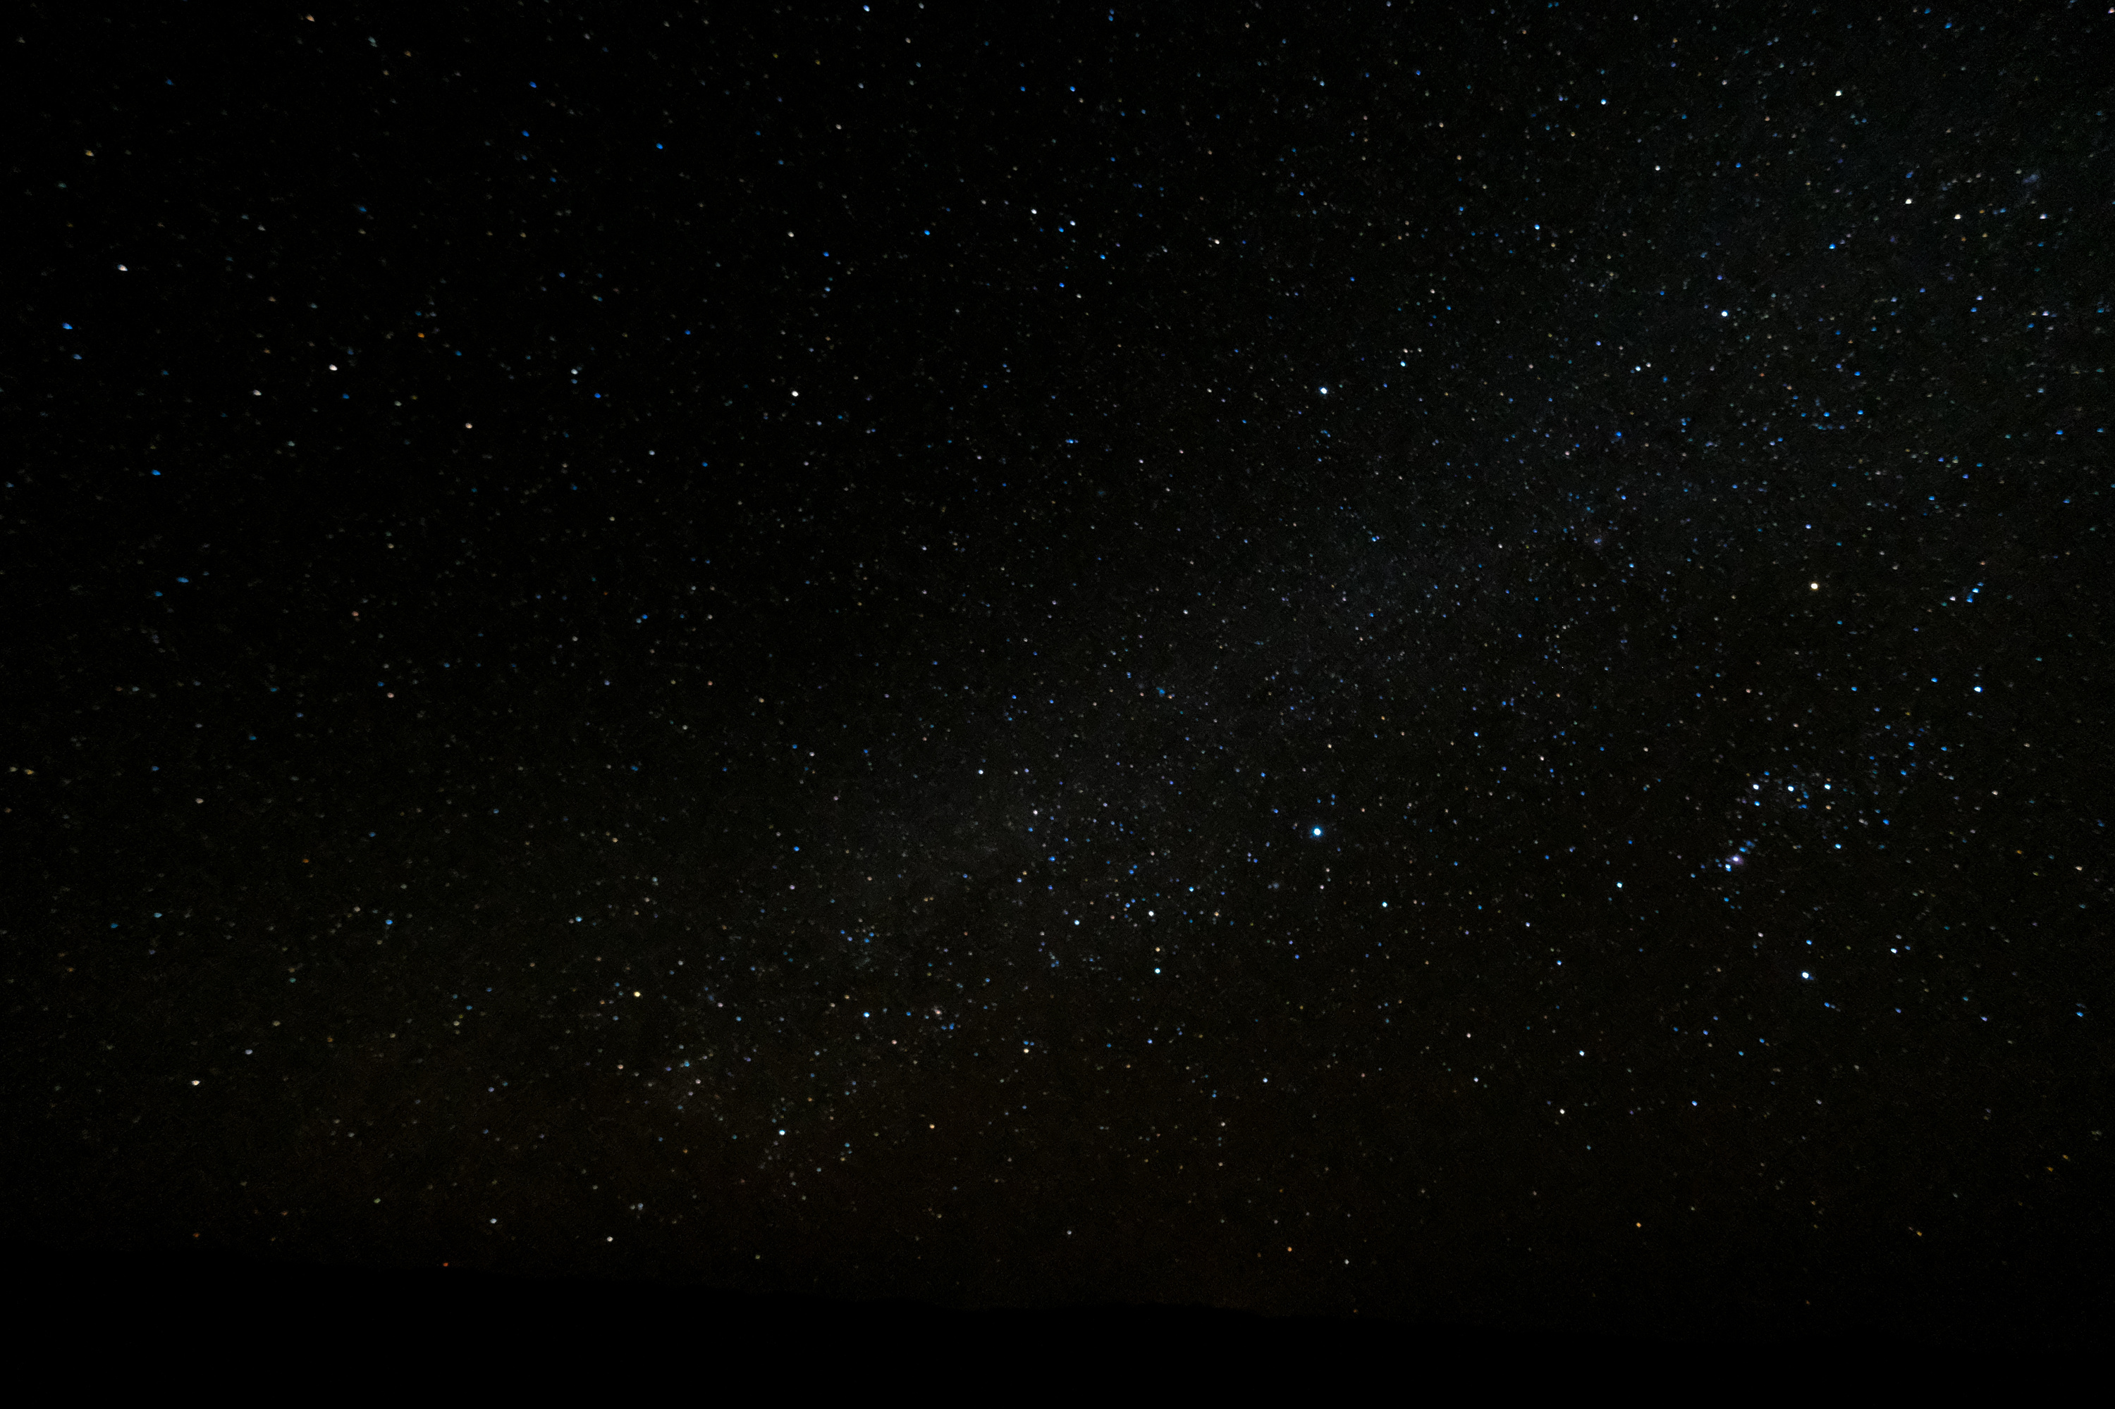
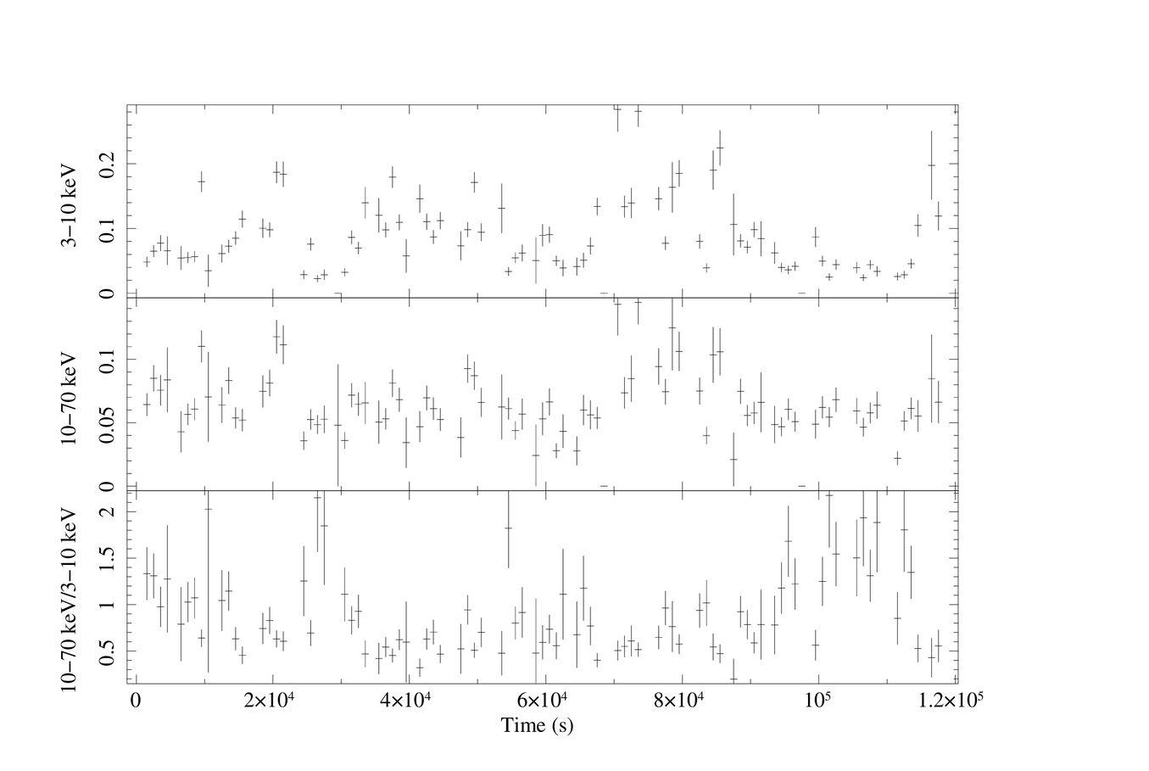
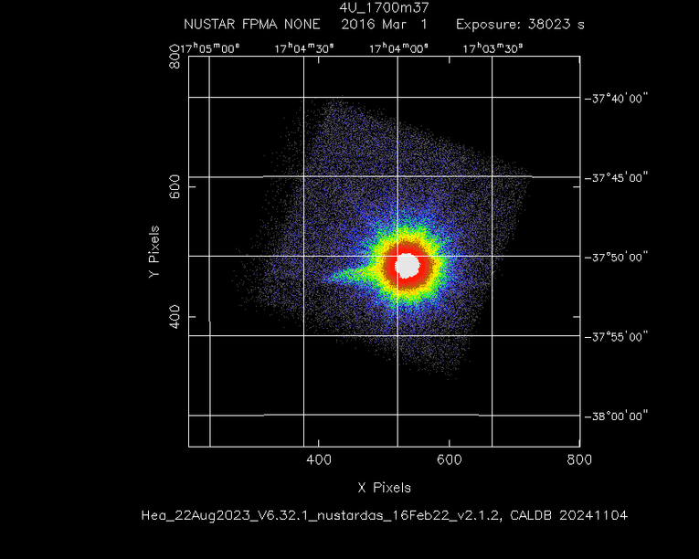

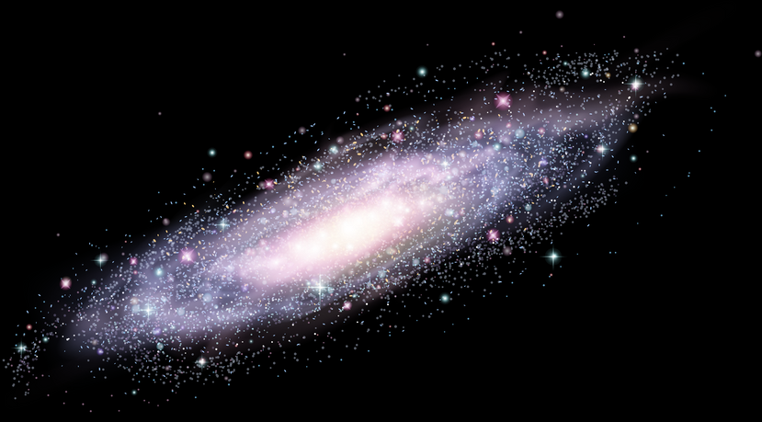
H
Image to left and timing to right
Hardness ratio is consistent over time expect the last segment (see arrow). Increased in hardness ratio indicates that there is increased absorption because of absorption in the stellar wind.
Page 06

Slide 7
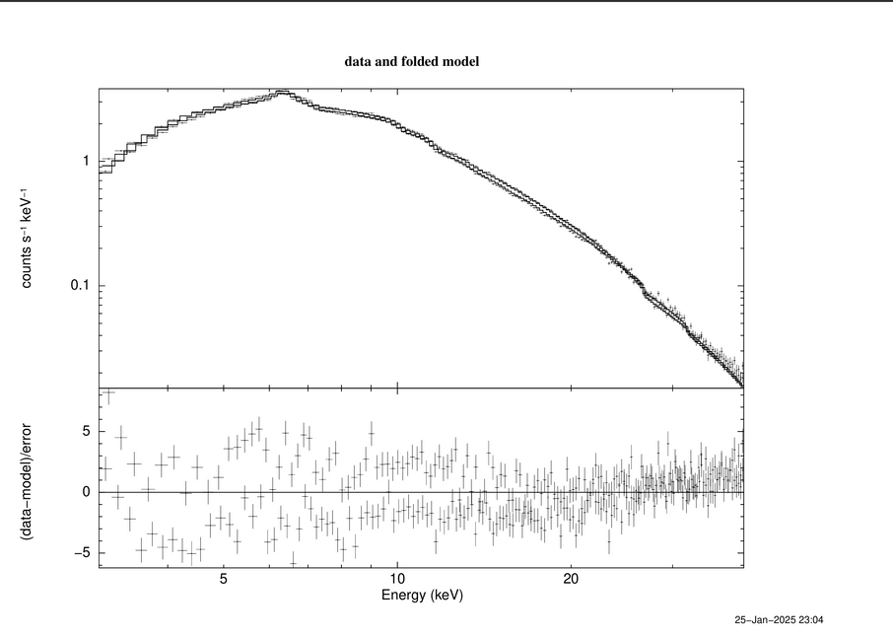
Spectral fitting
We fit the average spectrum to measure the absorption column density of ~3*10^22 atoms/cm^2.
Page 08
Page 07

Slide 8
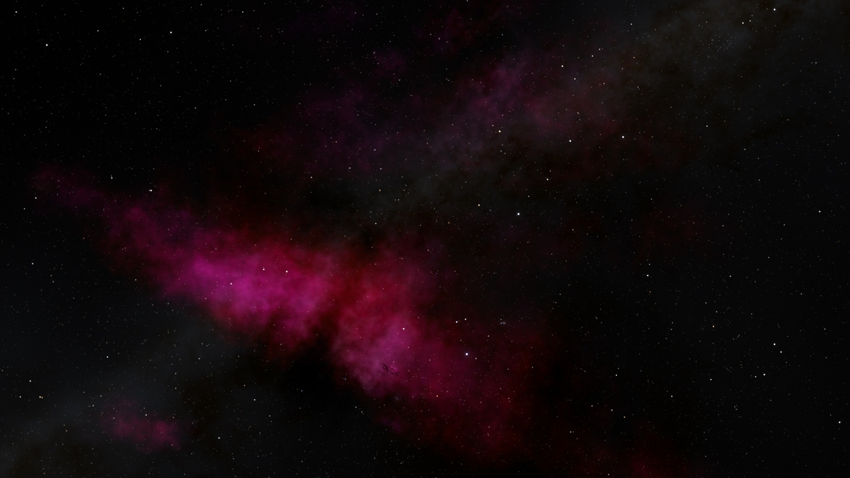
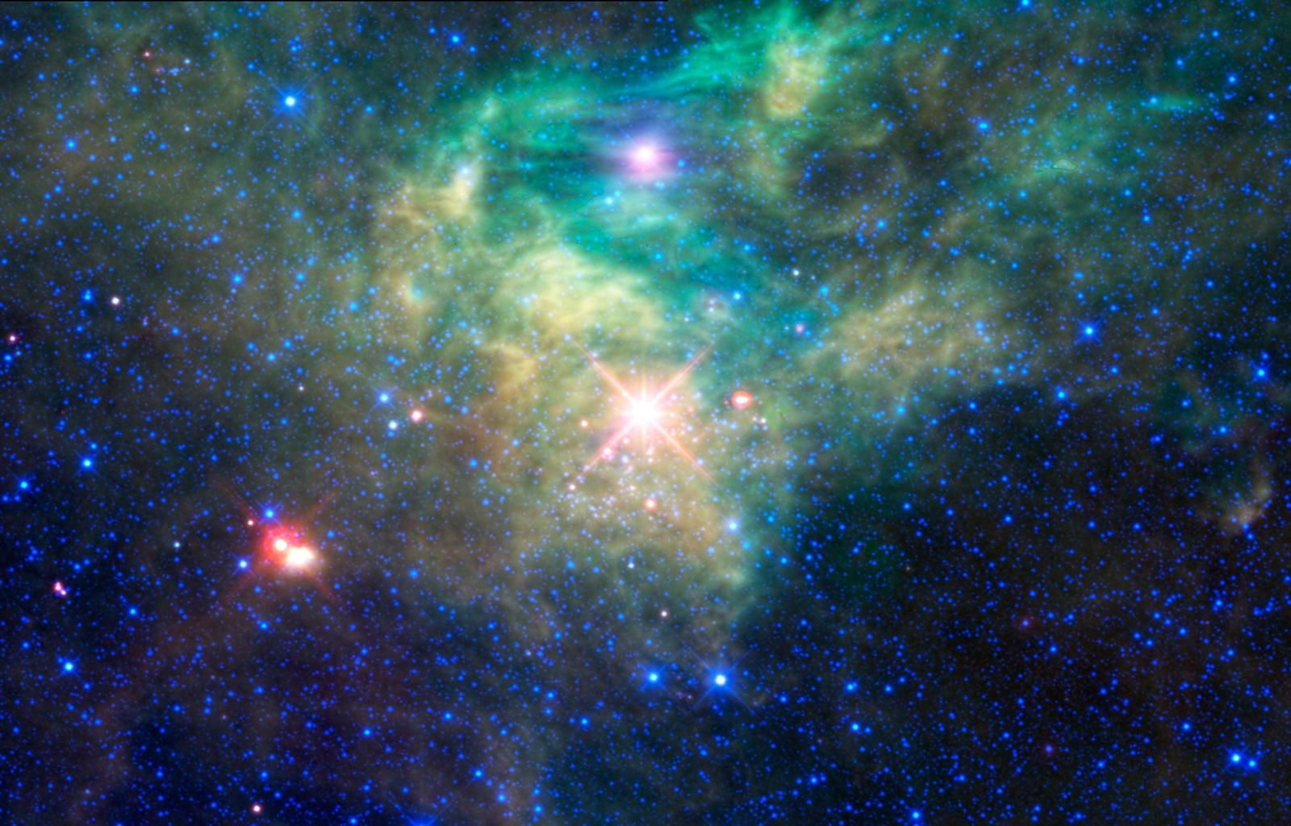
Future Directions
Measure absorption changes over small segments.
Estimate the size of the clump
Perform detailed spectral fitting to understand the nature of the companion star in the source (black hole versus neutron star)
Page 08

